Slide 1

Gambler’s fallacy
Notes on Behavioural Economics
Jason Collins

Slide 2
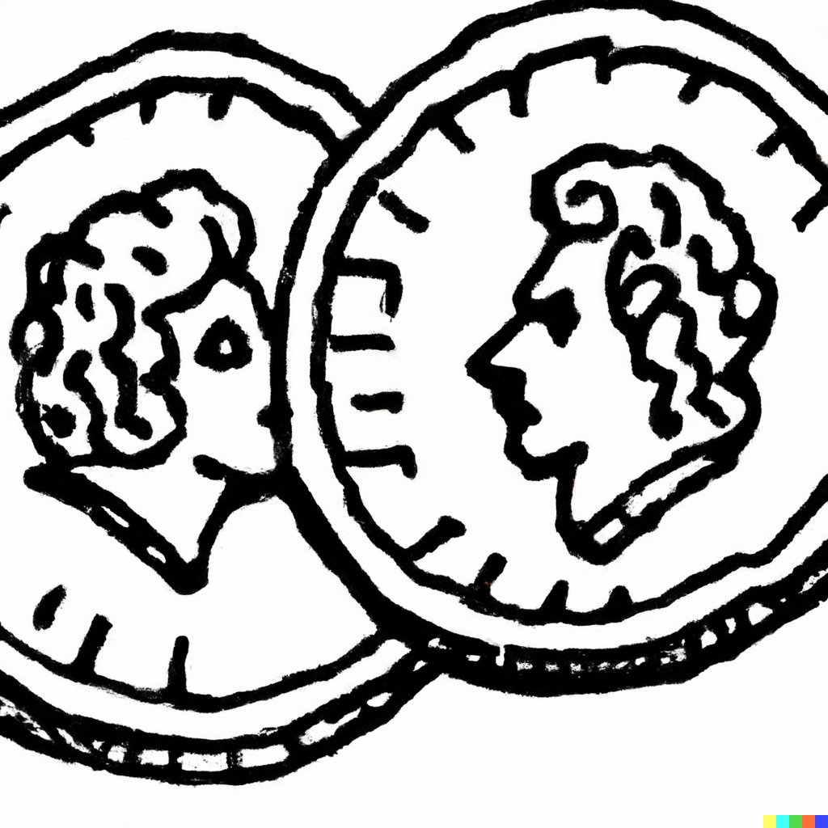
2

Slide 3
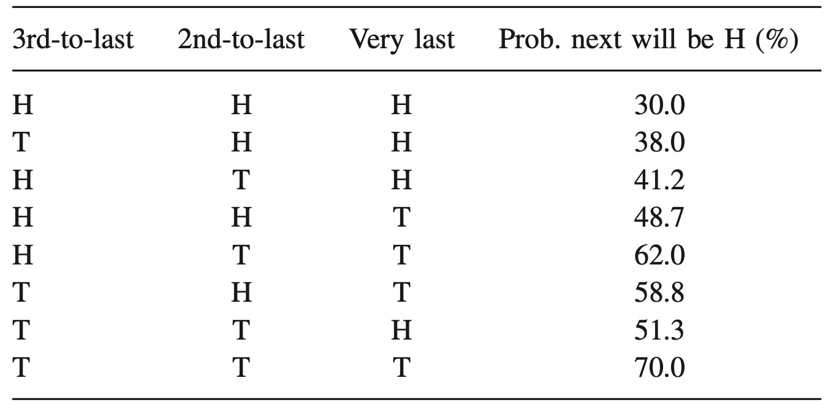
Probability of a head

Slide 4
Gambler’s fallacy
HHHHHH
HHTTHH

Slide 5
The law of small numbers

Slide 6
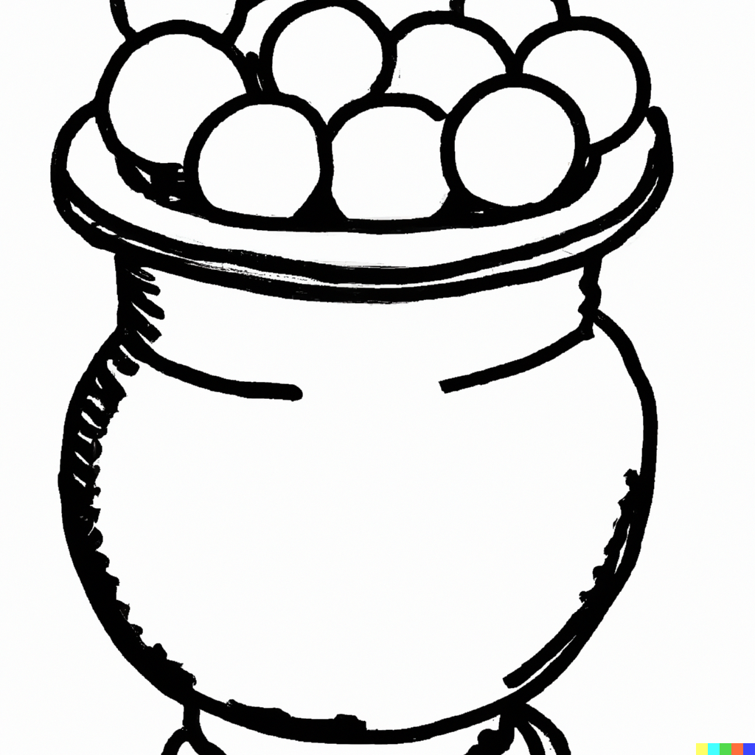

Slide 7


Slide 8
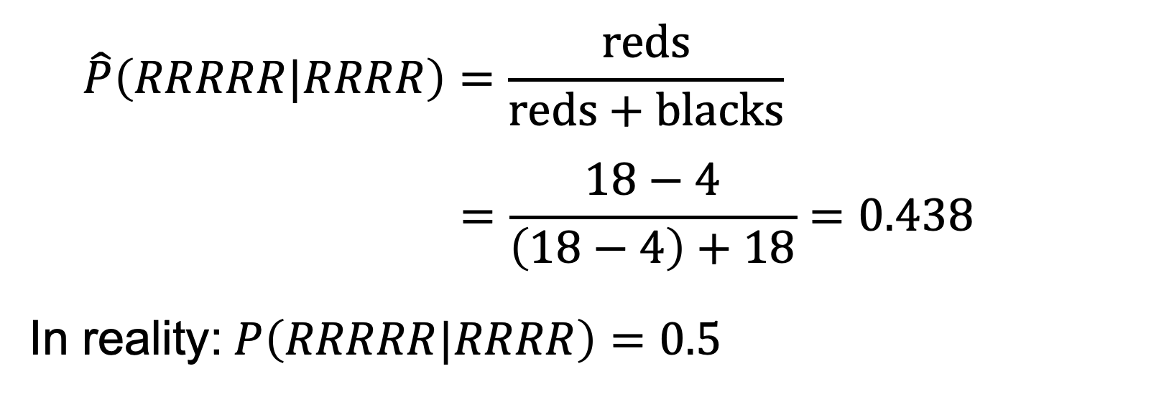
The law of small numbers
$$\hat{P}\left(RRRRR|RRRR\right)=\frac{reds}{reds+blacks}$$
$$=\frac{18−4}{\left(18−4\right)+18}=0.438$$
In reality:$P\left(RRRRR|RRRR\right)=0.5$

